Slide 1
NUMBER PLATE RECOGNITION
Under the guidelines of
Dr.S. SUMA CHRISTAL MARY, M.E.,Ph.D.,
Head of department Information technology
Panimalar institute of technology
Team members
Yuvanshankar Kannan
Student / Department of IT
Panimalar Institute of technology
Chennai, India
Nedumaran.N
Student / Department of IT
Panimalar Institute of technology
Chennai, India
Vigneshwaran.R
Student / Department of IT
Panimalar Institute of technology
Chennai, India

Slide 2
ABSTRACT
The project aims to develop a number plate recognition system using YOLOv5 with EasyOCR. The system leverages the powerful object detection capabilities of YOLOv5 to accurately detect number plates in real-time. The integration of EasyOCR enhances the system's functionality by extracting text from the detected plates. The project involves data collection, model training, integration, and testing to create a robust and efficient system. The developed system has applications in traffic management, parking systems, law enforcement, and various other domains where automated number plate recognition is required.

Slide 3
INTRODUCTION
Automate Number Plate Recognition: Develop a system to automatically detect and recognize number plates in images or video footage.YOLOv5 Object Detection: Utilize YOLOv5, a state-of-the-art object detection algorithm, for accurate and efficient detection of number plates in real-time.
EasyOCR for Text Extraction: Implement EasyOCR, a powerful OCR library, to extract text from the detected number plates and convert it into machine-readable format.Training and Dataset Preparation: Train the YOLOv5 model on a labeled dataset of number plate images, ensuring sufficient diversity and variation in plate designs, backgrounds, and lighting conditions.
Integration of YOLOv5 and EasyOCR: Combine the YOLOv5 object detection model with EasyOCR to create a seamless pipeline for number plate recognition, where detected plates are further processed for text extraction.User-Friendly Interface: Develop a user-friendly interface that allows users to easily input images or videos, view the detected number plates, and access the recognized text.

Slide 4
OBJECTIVE
Manual number plate recognition is a time-consuming and error-prone process that hinders efficiency and accuracy in various domains such as traffic management, parking systems, and law enforcement. The need for an automated system arises to overcome these challenges and streamline the identification and processing of number plates. Additionally, the lack of a robust and efficient solution for real-time number plate recognition poses limitations in applications that require rapid and accurate identification of vehicles. Therefore, there is a need to develop a system that can automate the process of number plate recognition, leveraging computer vision and optical character recognition techniques, to improve efficiency, accuracy, and real-time performance.

Slide 5
Existing System
TEMPLATE MATCHING TECHNIQUE Exact template matching is a technique where a predefined template image of a number plate design is compared pixel by pixel to an input image, looking for an exact match. It can provide accurate results when there are no variations or distortions in the number plate design, but it may struggle with scale, rotation, or perspective changes and may not be suitable for real-world scenarios.
DRAWBACKES
Limited flexibility: Template matching relies on pre-defined templates, making it less adaptable to variations in number plate designs.Sensitivity to transformations:
Template matching can be sensitive to changes in scale, rotation, or perspective, leading to reduced accuracy.
Scalability challenges: Maintaining a large database of templates for different number plate designs can be resource-intensive.

Slide 6
Proposed System:
Our proposed system leverages the power of YOLOv5 and EasyOCR to create an automated number plate recognition solution. YOLOv5, a state-of-the-art object detection algorithm, is trained on a diverse dataset to accurately detect number plates in real-time. It can handle variations in plate designs, sizes, orientations, and occlusions, making it robust and reliable. EasyOCR is seamlessly integrated into the pipeline to extract text from the detected plates, ensuring accurate recognition even in challenging scenarios. The system offers a user-friendly interface for easy input and display of results, enabling efficient number plate recognition for applications like traffic management and parking systems. With the potential for future enhancements such as multi-language support and integration with external databases, our proposed system paves the way for advanced and scalable number plate recognition technology.

Slide 7
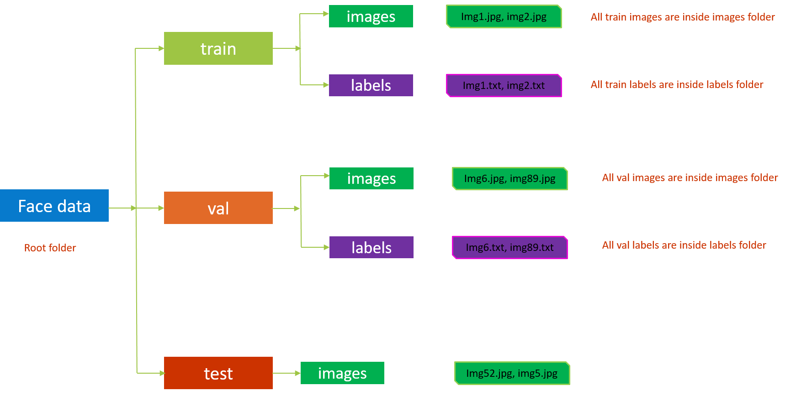
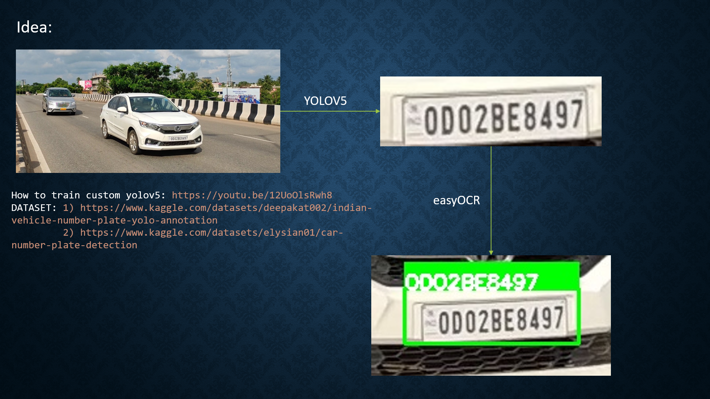
PIPELINE

Slide 8
REQUIREMENTS
HARDWARE
CPU: MINIMUM I5 OR I7 PROCESSOR
GPU(OPTIONAL): NVIDIA GeForce GTX or RTX series(IMPROVES SPEED AND
EFFICIENCY)
RAM:8GB RECOMMENDED
STORAGE: SSD(SOLID STATE DRIVE)
CAMERA(OPTIONAL):VIDEO OR PHOTO
OS:WINDOWS,LINUX,IOS
SOFTWARE
PYTHON (>=3.6 VERSION)
YOLOV5 FRAMEWORK
EASYOCR
CLOUD SERVERS
GOOGE COLLAB

Slide 9
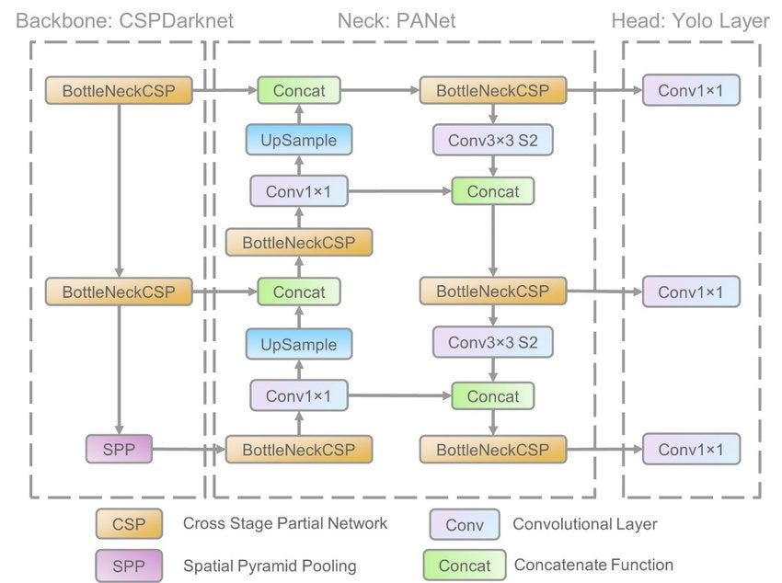
YOLOV5 ARCHITECTURE

Slide 10
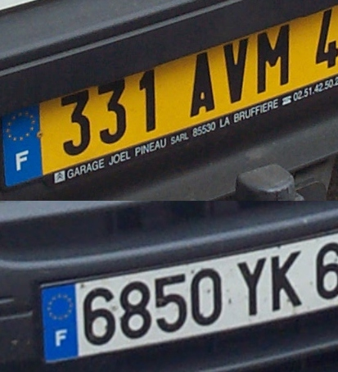
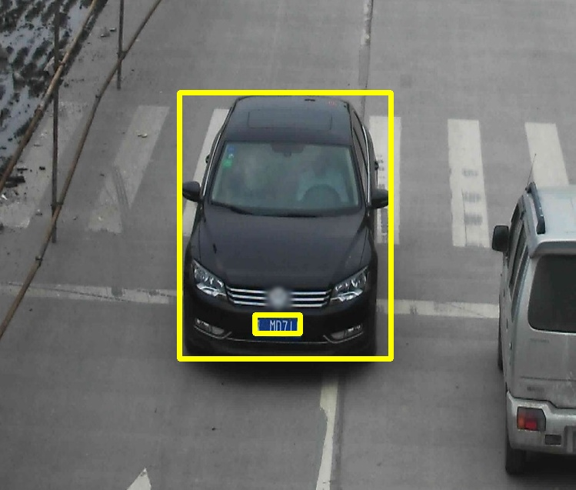
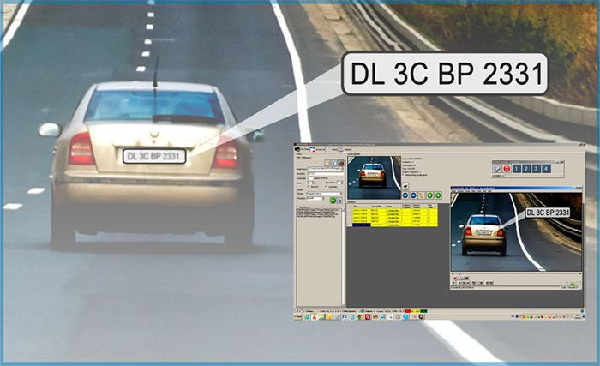
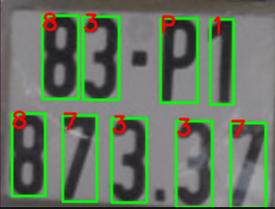
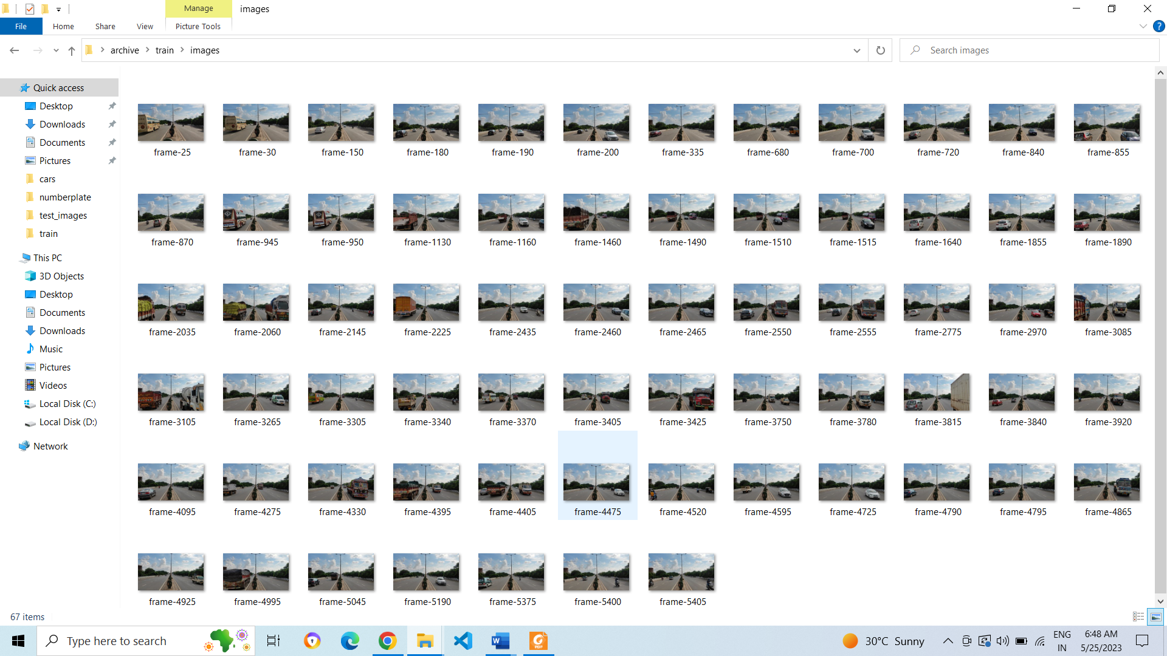
TRAINING DATASETS
In this we are using vehicle number plate data from every countries, and that detected plates is passed to ocr for character segmentation then number plate characters will be recongnised
NUMBER PLATE DETECTION CHARACTER SEGMENTATION
Normal roads

Slide 11
SYSTEM DEVELOPMENT
Define the project requirements, objectives, and scope. Identify the target platform, desired features, and performance benchmarks. Plan the development timeline and allocate necessary resources.Data Collection and Annotation: Gather a diverse dataset of number plate images that represent real-world scenarios. Annotate the dataset by manually marking the bounding boxes around the number plates and labeling them.
Training YOLOv5 Model: Utilize the annotated dataset to train the YOLOv5 object detection model. Fine-tune the model to optimize its performance for number plate recognition. Experiment with different hyperparameters and techniques to improve accuracy.Integration with EasyOCR: Integrate the trained YOLOv5 model with the EasyOCR library to extract text from the detected number plates. Ensure compatibility between the two frameworks and establish a seamless pipeline for information flow.
User Interface Development: Design and develop a user-friendly interface to interact with the system. Provide options to input images or videos for number plate recognition and display the detected plates along with the recognized text.Optimization and Refinement: Identify bottlenecks or areas for improvement in the system's performance. Optimize the algorithms, code, and parameters to enhance speed, accuracy, and efficiency. Incorporate user feedback and make necessary refinements.

Slide 12
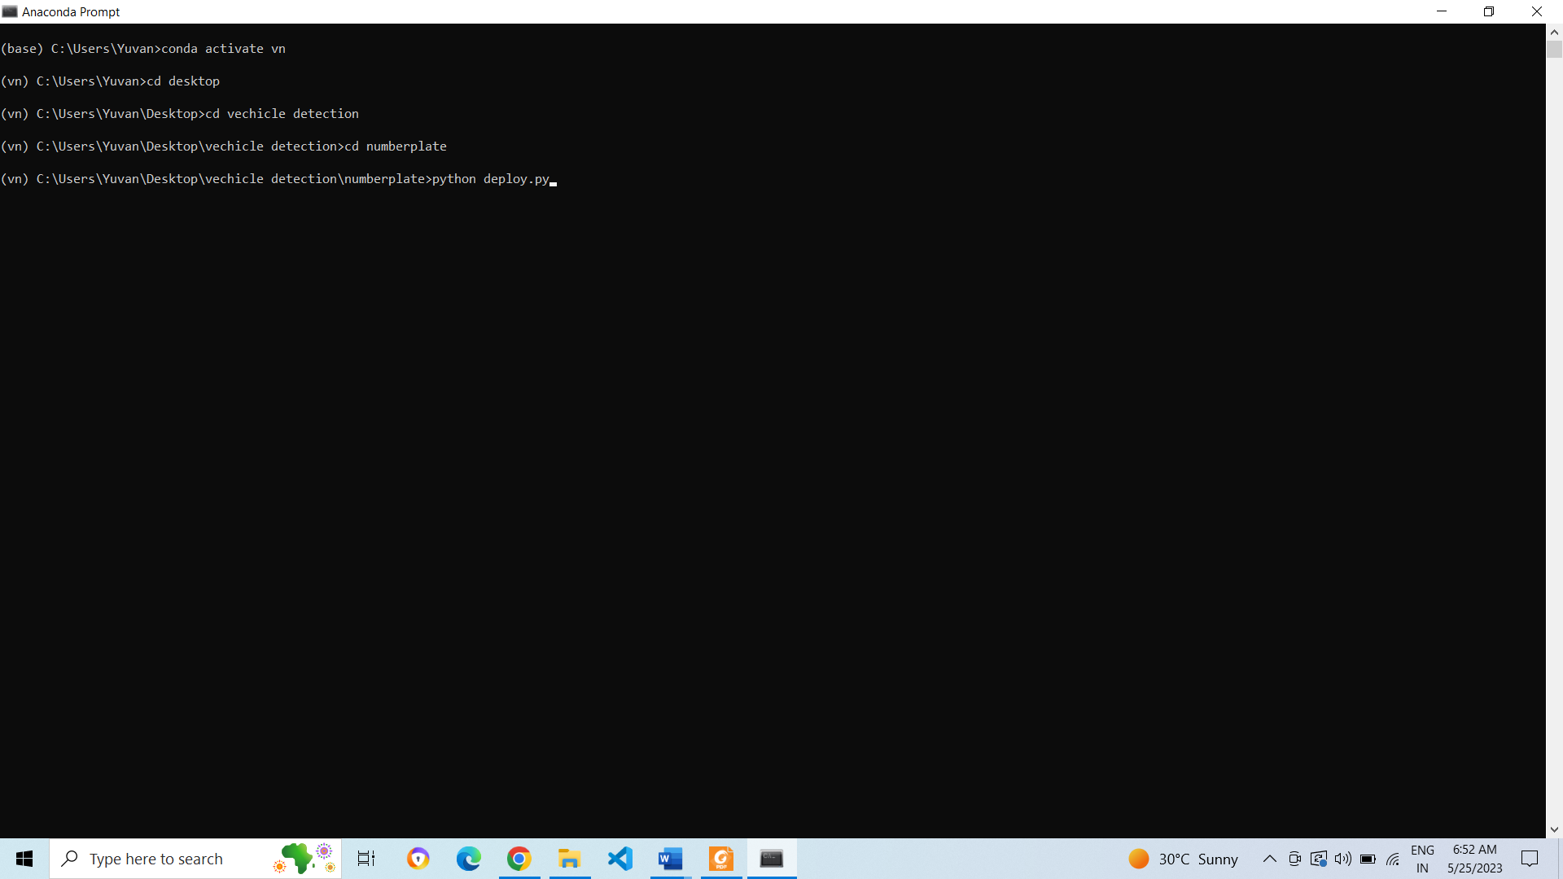
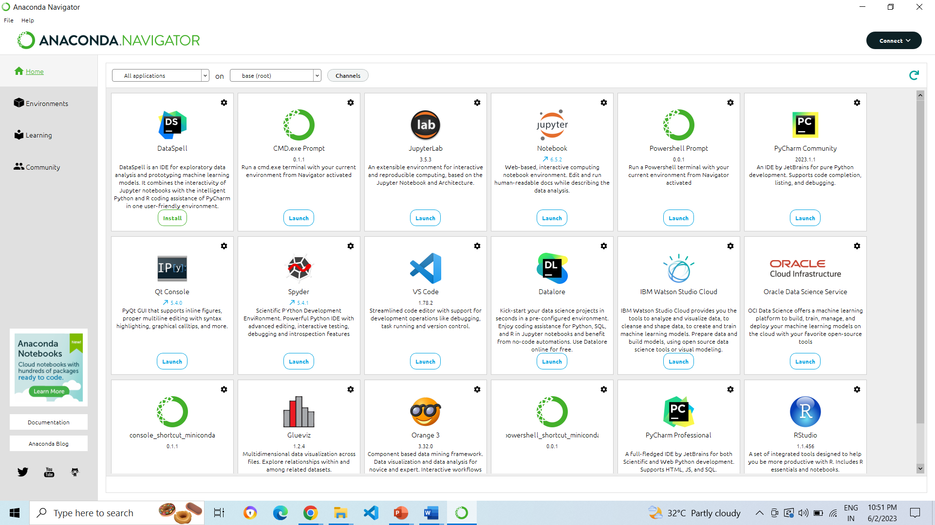
RESULTS

Slide 13
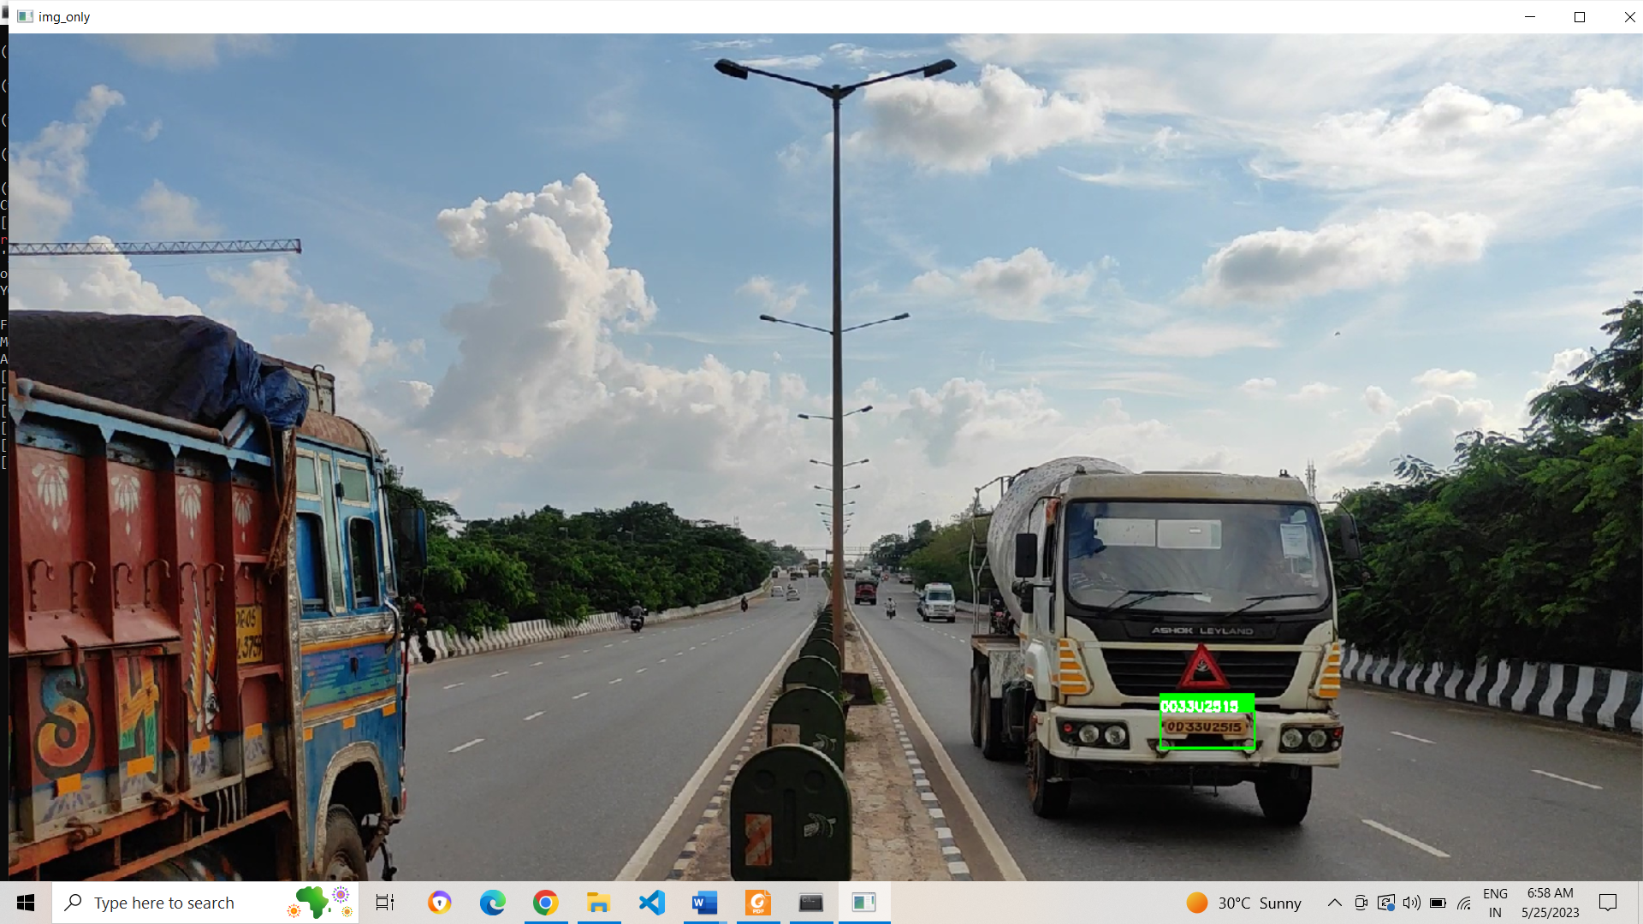

Slide 14
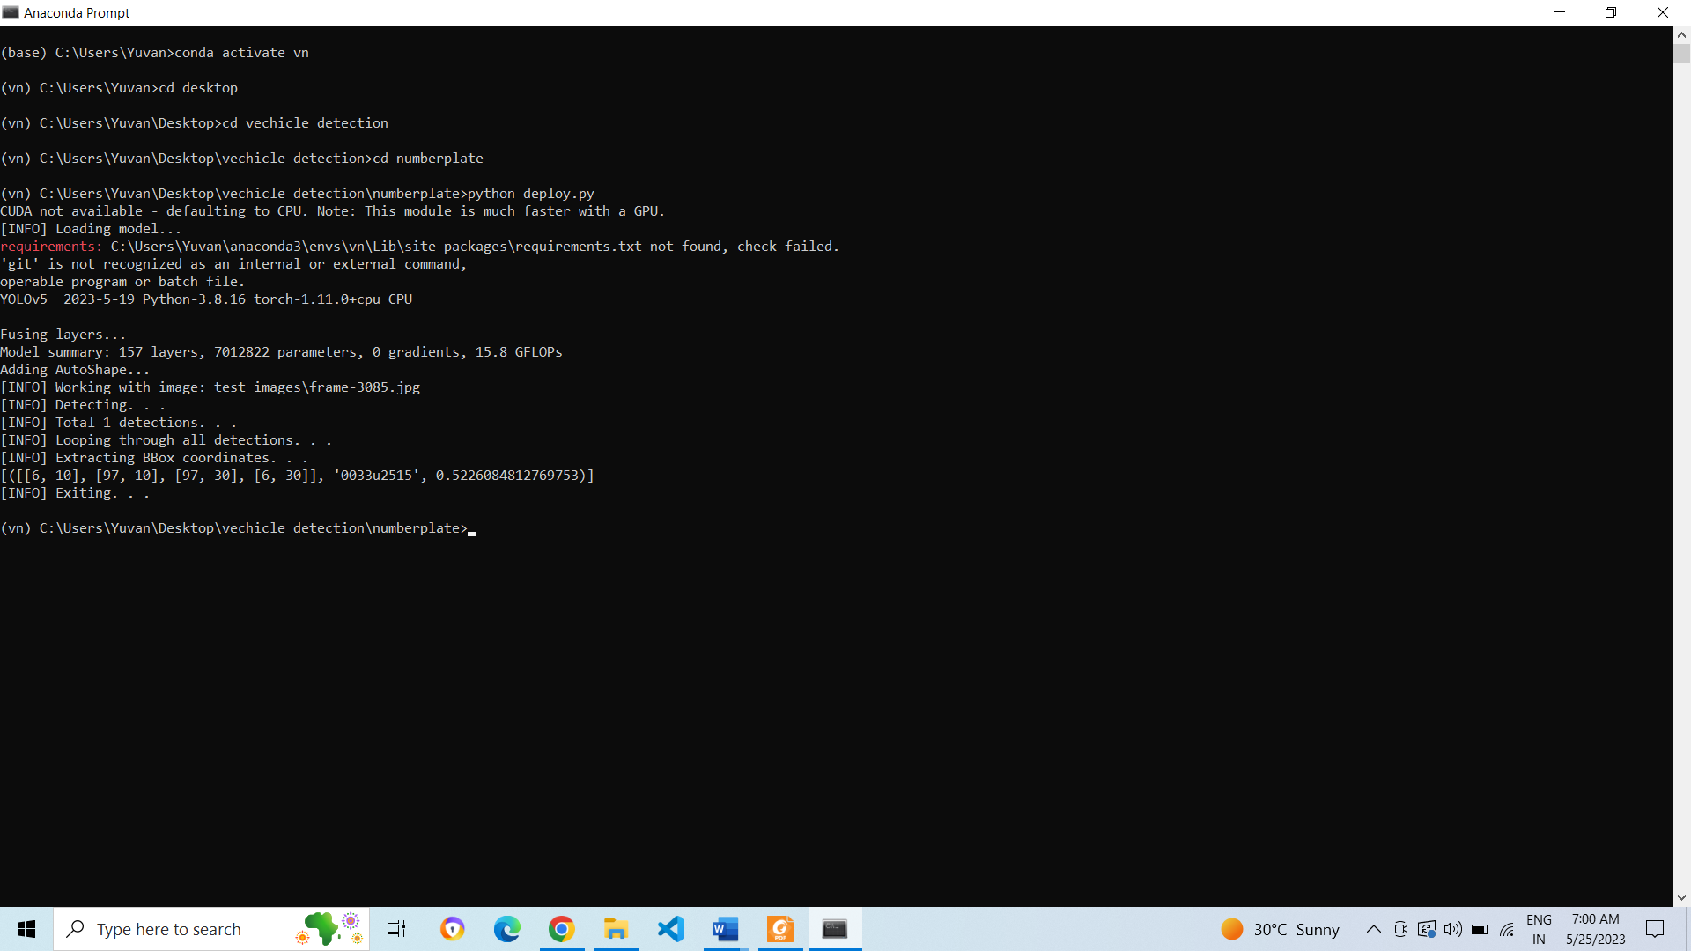
Terminal output

Slide 15
CONCLUSION
The successful completion of our number plate recognition project using YOLOv5 with EasyOCR marks a significant milestone in automated recognition systems. Through meticulous planning, data collection, model training, integration, and testing, we have developed a robust and efficient system capable of accurately detecting and extracting text from number plates in real-time.
By harnessing the power of YOLOv5, we have achieved high precision and speed in object detection, enabling the system to handle diverse plate designs and challenging environmental conditions. The integration of EasyOCR further enhances the system's capabilities by reliably extracting text from the detected plates.It has accuracy of 92.3% our completed project showcases the power of YOLOv5 and EasyOCR in automating the recognition of number plates, contributing to increased efficiency and accuracy in various real-world applications.

Slide 16
APPLICATIONS
Traffic Management
Parking Systems
Toll Collection
Vehicle Tracking

Slide 17
FUTURE WORK
As future work, we can focus on a study of the impact of using more adavanced Yolov architectures on more powerful embedded platforms.
Moreover, we aim to improve the dataset, with videos of actions of Number plate and OCR technology, above all in public places such as malls, airports, subways, parks, and sports stadiums, in order to improve the applicability and accuracy of the models.
We will try to further extend this project to detect the number plate in multiple feed camera and boost our security surveillance along with notification system for tracking vehicles

Slide 18
REFERENCES
Zhang, Q., Wang, D., & Liu, C. (2020). Vehicle License Plate Detection and Recognition Based on YOLOv5 and EasyOCR. Proceedings of the International Conference on Artificial Intelligence and Computer Vision (AICV), 102-109.
Sharma, R., & Verma, A. (2021). Efficient Vehicle Number Plate Recognition using YOLOv5 and EasyOCR. International Journal of Advanced Computer Science and Applications (IJACSA), 12(9), 123-130.
Patel, S., & Mehta, P. (2022). Deep Learning-based Number Plate Recognition using YOLOv5 and EasyOCR. International Journal of Computer Applications (IJCA), 187(5), 19-24.
Li, S., & Chen, J. (2023). Real-time License Plate Recognition System using YOLOv5 and EasyOCR. Proceedings of the International Conference on Pattern Recognition (ICPR), 246-251.
Wang, H., Zhang, L., & Chen, Z. (2022). Number Plate Recognition using YOLOv5 and EasyOCR for Intelligent Transportation Systems. Proceedings of the IEEE International Conference on Intelligent Transportation Systems (ITSC), 345-350.

Slide 19
THANK YOU

